Slide 1


Movement Tutorial
This tutorial is for first person movement

Slide 2
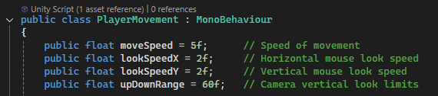
Movement explanation of the script
Public in programming is a variable that can be modified from an outside the script. This can allow other game developers to change things to work more correctly. A private float is restricted access meaning that no developer can edit this script.
Why would I use a public float? It is more convenient because if I used private, I would only be able to change within the code whereas if it was public, I can change it in unity
Float shows the type of data the variable will hold. Float can include numbers with decimal points and these numbers can be used to make movement, rotations and speed.
moveSpeed: controls how fast a player can move.
lookSpeedX and LookSpeedY: This gives the camera a rotation speed when the person uses the mouse.
upDownRange: keeps the camera stable
Problems: Camera kept flipping upside down, so I had to use upDownRange to prevent this.

Slide 3
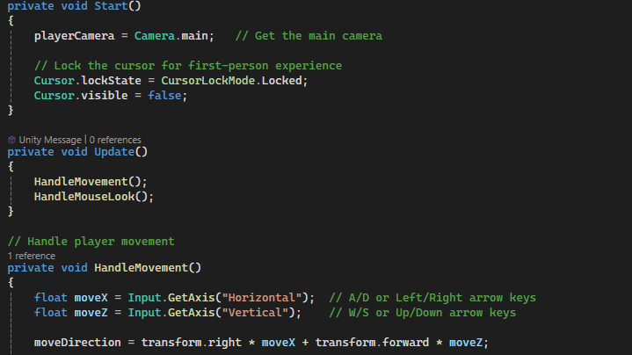
Movement explanation of the script .2
Cursor LockState is used to control the mouse cursors behaviour within the game. This code is very helpful for when you are making a first-person game, and you need to handle camera control
What is the purpose of Cursor Lockstate? The purpose it to lock the camera in place in a first-person view, if you did not do this, your camera would be moving away from your player
I used the start method to make the player camera lock to the centre of the screen so the I can move my player in first person.
I used the update method with the codes, HandleMovement and HandleMouseLook so that all the frames update the player’s camera and position

Slide 4
Movement explanation of the script .3
Handle movement controls how the Game Object moves. This is useful for better gameplay movement. This gives the game object access to running or jumping.
Inputs like WASD can be used for movement which shows a sense of direction.
Calculating movement to see the speed of movement in each direction.

Slide 5
Movement explanation of the script .4
A private void can be used to keep methods hidden.
Void is when the method does return to a value.
If HandleMovement is private, then it can only be used inside the script.

